Slide 2
Title:The challenges for effective control of ASF in Nigeria
Presenter: Pam Luka
Country and institution: Nigeria, NVRI, Vom

Slide 3
Overview
Endemic: 1st reported in 1996
Seroprevalence of up to 3.9-9% and tissue positivity of 24 – 48% (Fasina et al, 2010; Luka et al 2017)
Spread to more that 22 of the 36 states of the country
Genotype I and II circulating

Slide 5
Biosecurity – Knowledge
Table showing 64.4% of respondents with history of ASF outbreak-2020,
Variables |  | Had ASF outbreak (n=67) | Not had ASF outbreak (n=37 | P-value | OR, 95% CI
Know the cause of ASF |  |  |  | 0.25 | 1.424 (0.63,3.20)
 | Yes | 33 (31.7) | 15 (14.4)
 | No | 34 (31.7) | 22 (21.2)
Mentioned signs of ASF |  |  |  | 0 | 9.632(3.34, 27.73)
 | Yes | 61 (58.7) | 19 (18.3)
 | No | 6 (5.8) | 18 (17.3)
Know how it spreads |  |  |  | 0.02 | 2.464 (1.08,5.60)
 | yes | 42 (40.4) | 15 (14.4)
 | No | 25 (24.0) | 22 (21.2)

Slide 6
Practices associated with the history of ASF outbreaks mentioned by participants

Slide 8
Live animal market/Movement

Slide 13
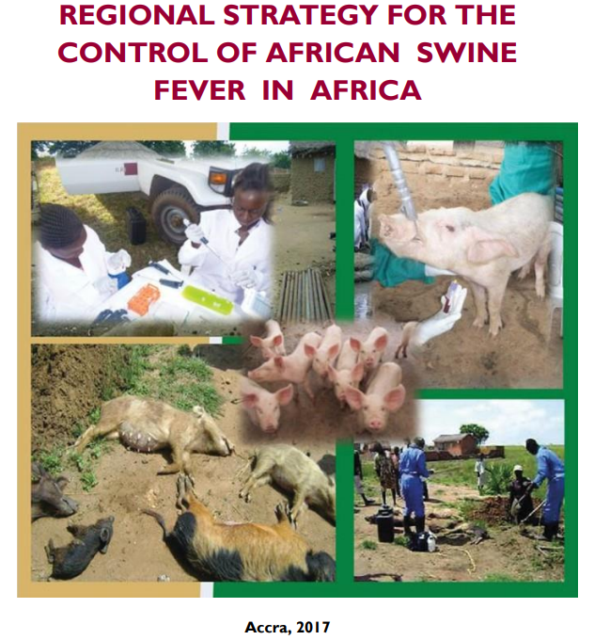

Slide 15
Acknowledgment
AU ASF-RESIST
NVRI Vom
USDA – CRDF Global
GARA
PiFAN

Slide 16
References
Fasina, F. O., Shamaki, D., Makinde, A. A., Lombin, L. H., Lazarus, D. D., Rufai, S. A., Adamu, S. S., Agom, D., Pelayo, V., Soler, A., Simón, A., Adedeji, A. J., … Gallardo, C. (2010). Surveillance for African swine fever in Nigeria, 2006-2009. Transboundary and emerging diseases, 57(4), 244–253. https://doi.org/10.1111/j.1865-1682.2010.01142.x
Luka, P. D., Achenbach, J. E., Mwiine, F. N., Lamien, C. E., Shamaki, D., Unger, H., & Erume, J. (2017). Genetic Characterization of Circulating African Swine Fever Viruses in Nigeria (2007-2015). Transboundary and emerging diseases, 64(5), 1598–1609. https://doi.org/10.1111/tbed.12553
Adedeji, A. J., Luka, P. D., Atai, R. B., Olubade, T. A., Hambolu, D. A., Ogunleye, M. A., Muwanika, V. B., & Masembe, C. (2021). First-Time Presence of African Swine Fever Virus Genotype II in Nigeria. Microbiology resource announcements, 10(26), e0035021. https://doi.org/10.1128/MRA.00350-21

